Slide 1
Partition Problem (Number Partition Problem)
报告人：沈浩靖
学号：1900271023
课程：大数据并行算法
指导老师：廖好

Slide 2
目录
问题描述
解决方法
并行策略
引用

Slide 3
问题描述

Slide 4





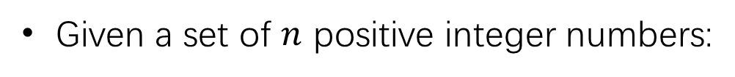
问题描述：Partition Problem (Number Partition Problem)
Given a set of $n$ positive integer numbers:
then the two-way number partitioning problem consists in splitting the elements of S into two sets, S1 and S2 such that
For example:

Slide 5
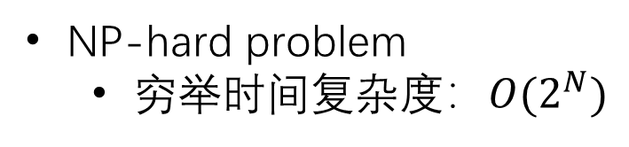
问题描述：Partition Problem (Number Partition Problem)
NP-hard problem
穷举时间复杂度：${O(2}^{N})$
1 0 1 0 1 1 0 0 0 1
问题的复杂度跟两个因素有关：
集合的长度
集合元素的大小

Slide 6
解决方法

Slide 7
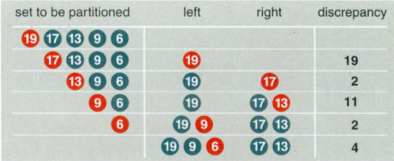
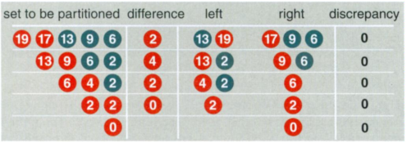
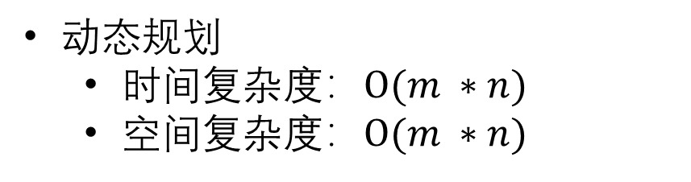
解决方法 1
贪婪算法
当集合的元素比较小时能保证求得完美解
m=27
n=10
Karmarkar-Karp 算法 [2]
动态规划
时间$复杂度：O(m ∗n)$
空间复杂度：$O(m ∗n)$
0
1
……
0
1
……
1 2 3 25 26 27
退化算法 [3]
遗传算法 [4]

Slide 8
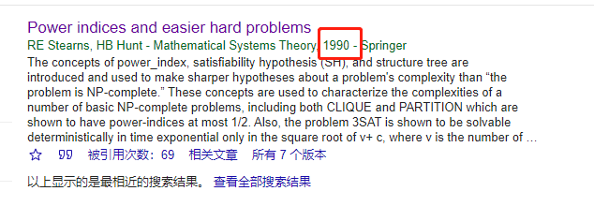
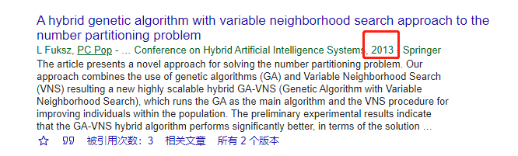
解决方法 2
动态规划+回溯法 [5]
变领域遗传算法 [6]

Slide 9
并行策略

Slide 10

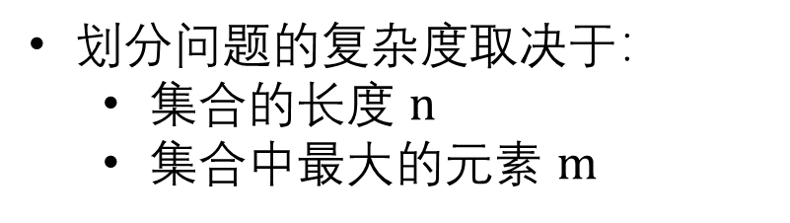

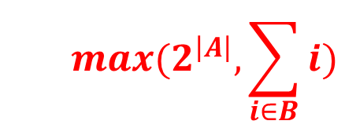
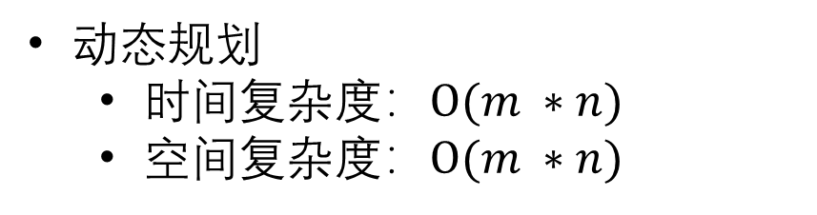
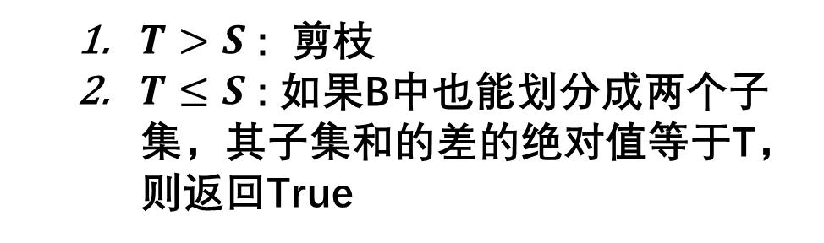
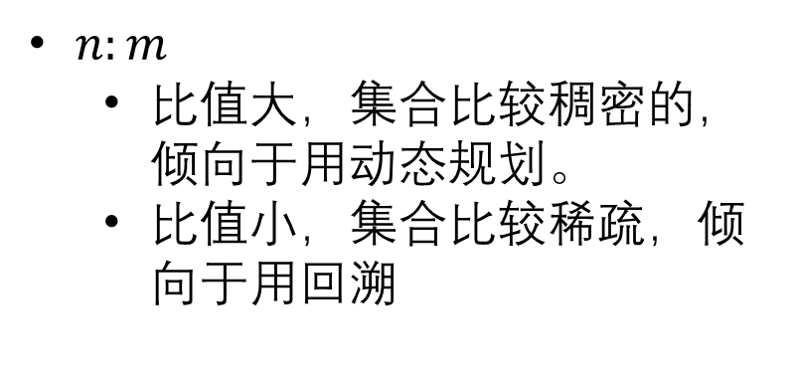

动态规划+回溯法与并行策略
划分问题的复杂度取决于：
集合的长度 $n$
集合中最大的元素 $m$
$$max(2^{\left|A\right|}, \sum_{i∈B}{i})$$
可并行
动态规划
时间$复杂度：O(m ∗n)$
空间复杂度：$O(m ∗n)$
A
B
回溯
动态规划
$n:m$
比值大，集合比较稠密的，倾向于用动态规划。
比值小，集合比较稀疏，倾向于用回溯
$$A_{1}$$
$$A_{2}$$
$$T= {|A}_{1}−A_{2}|$$
$T>S$ : 剪枝
$T≤S$ : 如果B中也能划分成两个子集，其子集和的差的绝对值等于T，则返回True

Slide 11
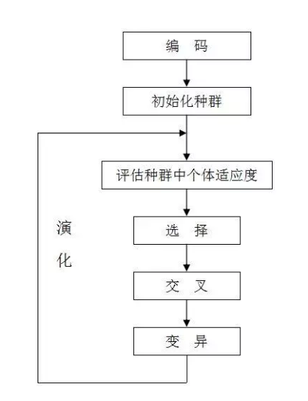
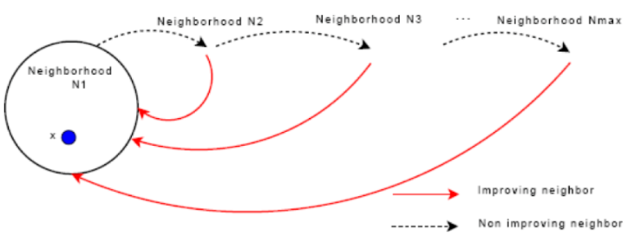
变领域遗传算法与并行策略
个体（基因型）：
1 0 1 0 1 1 0 0 0 1
个体（表现型）：
{2， 3， 5， 7， 2}
可并行
VNS

Slide 12
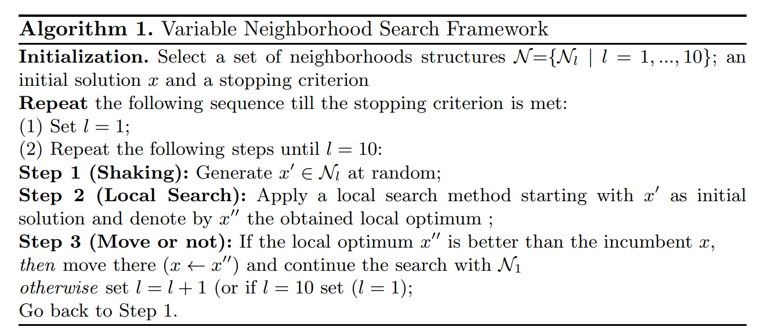
VNS

Slide 13
Hayes B. Computing science: The easiest hard problem[J]. American Scientist, 2002, 90(2): 113-117.
Fuksz L, Pop P C. A hybrid genetic algorithm with variable neighborhood search approach to the number partitioning problem[C]//International Conference on Hybrid Artificial Intelligence Systems. Springer, Berlin, Heidelberg, 2013: 649-658.
Junkermeier J. A Genetic Algorithm for the Number Partitioning Problem[J].
Hansen, P., Mladenovic, N.: Variable neighborhood search: Principles and applications. European Journal of Operational Research 130(3), 449–467 (2001)
引用
Hayes B. Computing science: The easiest hard problem[J]. American Scientist, 2002, 90(2): 113-117.
Karmarkar, N., Karp, R.M.: The differencing method of set partitioning, Technical Report UCB/CSD 82/113, Computer Science Division, University of California, Berkeley (1982)
Johnson, D.S., Aragon, C.R., McGeoch, L.A., Schevon, C.: Optimization by simulated annealing: An experimental evaluation; Part II: Graph coloring and number partitioning. Operations Research 39(3), 378–406 (1991)
Ruml, W., Ngo, J.T., Marks, J., Shieber, S.M.: Easily searched encodings for number partitioning. Journal of Optimization Theory and Applications 89(2), 251–291 (1996)
R. Stearns and H. Hunt. “Power Indices and Easier Hard Problems”. Mathematical Systems Theory 23, pp. 209-225, 1990.
Fuksz L, Pop P C. A hybrid genetic algorithm with variable neighborhood search approach to the number partitioning problem[C]//International Conference on Hybrid Artificial Intelligence Systems. Springer, Berlin, Heidelberg, 2013: 649-658

